Slide 1
Level 4/5 Group 5
Joseph Barber, Bethany Cowle,
Courtney-Jade Pearson, Henry Smith

Slide 2

Emotions: Onism and Monachopsis
Onism:
“The frustration of being stuck in just one body that inhabits only one place at a time.”
Created through the mechanics and gameplay
Monachopsis:
“The subtle but persistent feeling of being out of place.”
Created through the narrative
HS & BC

Slide 3
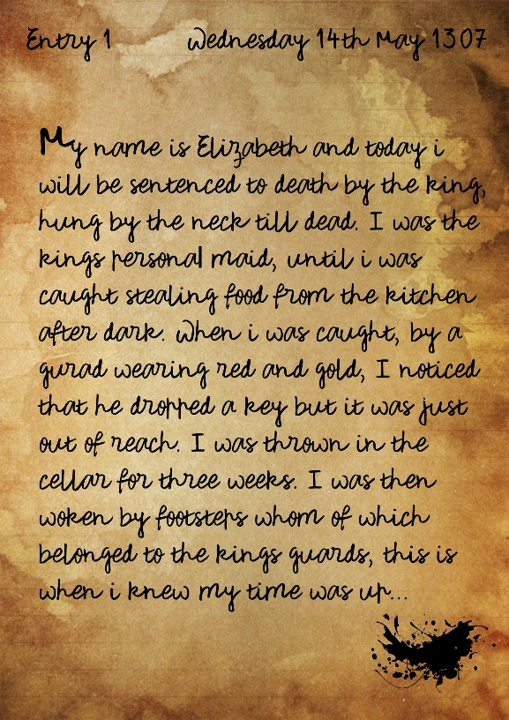
Narrative
Build narrative as you play.
Collecting memories.
Character feels emotions along with the player.
Monachopsis in narrative
HS

Slide 4
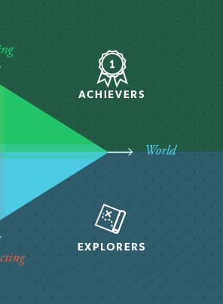
Target Demographic
Bartle’s taxonomy of Player Types: Achievers and Explorers
Age: 16 – 30
Gender: Males and females
CP

Slide 5
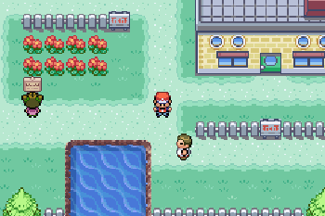
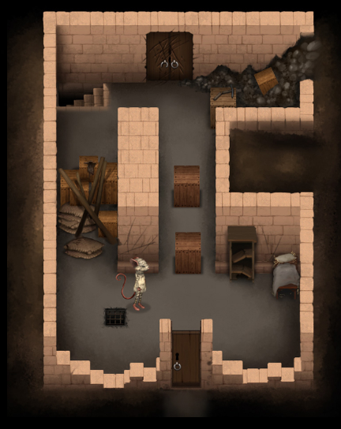
Genre/Style
Puzzle
Strategy
Angled top-down perspective
BC

Slide 6
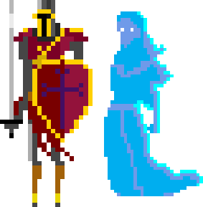
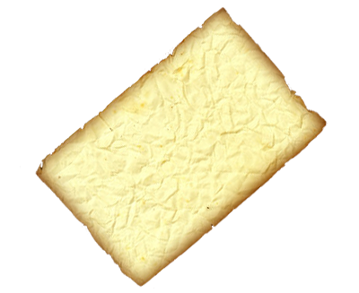
Unique Selling Point
Unravel narrative through gameplay
Take control of NPCs in the game world
Access different mechanics upon taking over an NPC
JB

Slide 7
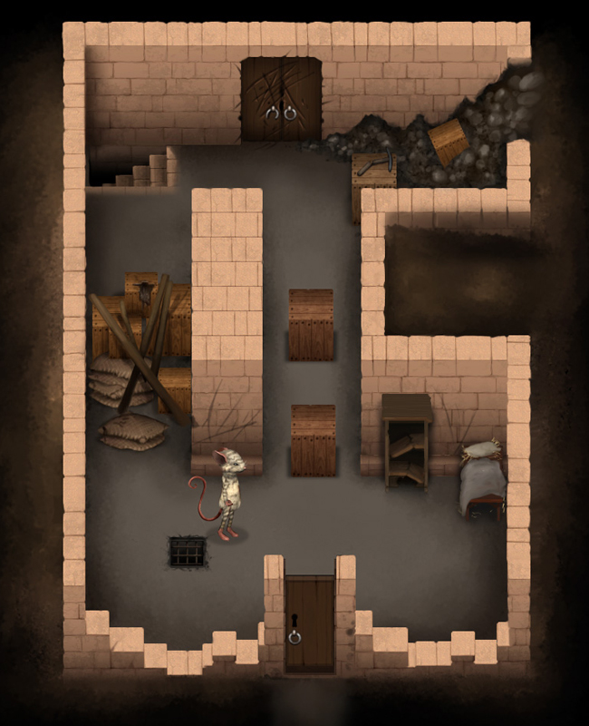

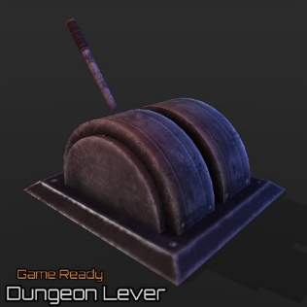
Mechanics: What does the player do?
Walk
Take control of NPCs
Operate objects Key/locks Switches/levers/ buttons etc.
This will cost one “Charge”
JB

Slide 8


Player Rewards
Collect diary memories Over time, piece together narrative.
Collecting additional “Charges”
CP

Slide 9
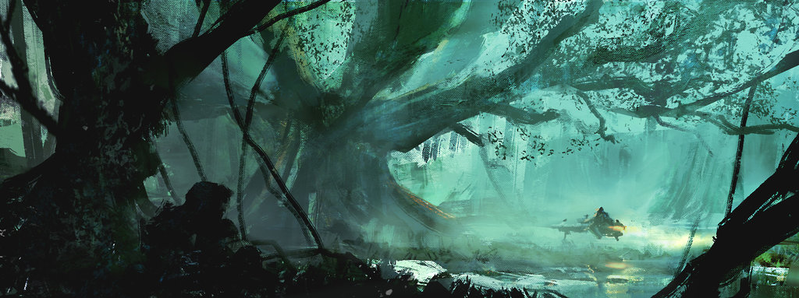
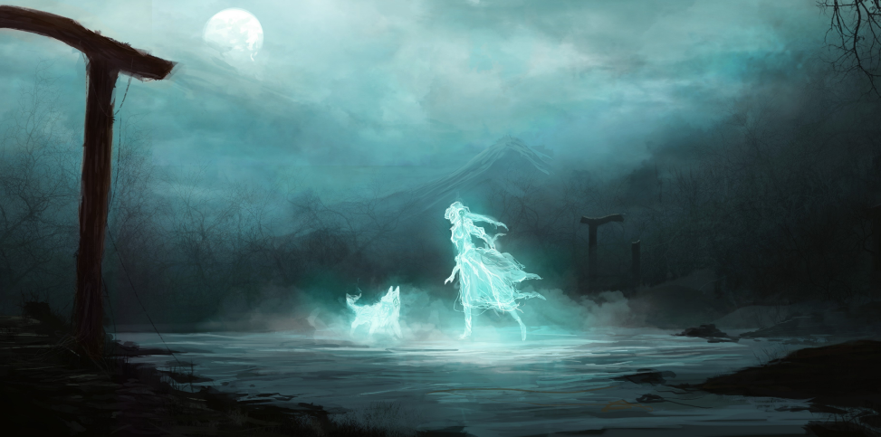


Mood boards
HS

Slide 10
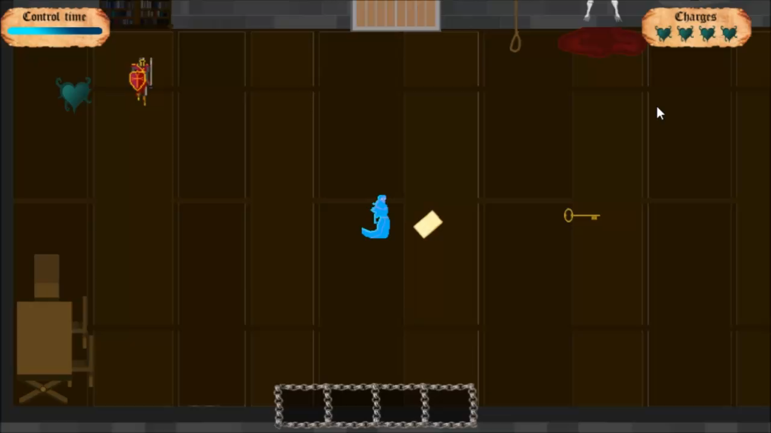
Gameplay video
Gameplay

Slide 11
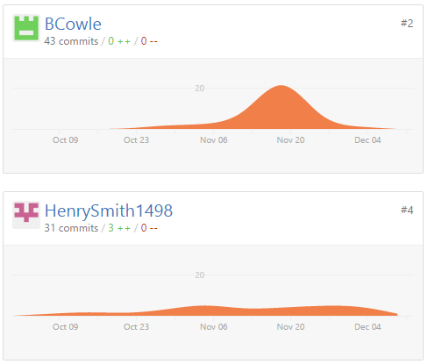
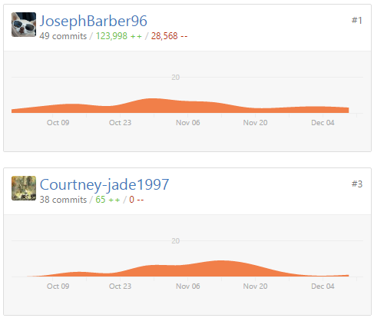
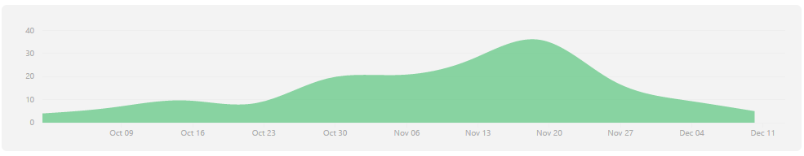
Management
Hours logged
JB : 27hours 30min
BC: 27hours
CP: 26hours 30min
HS: 26hours 30min
JB & CP

Slide 12

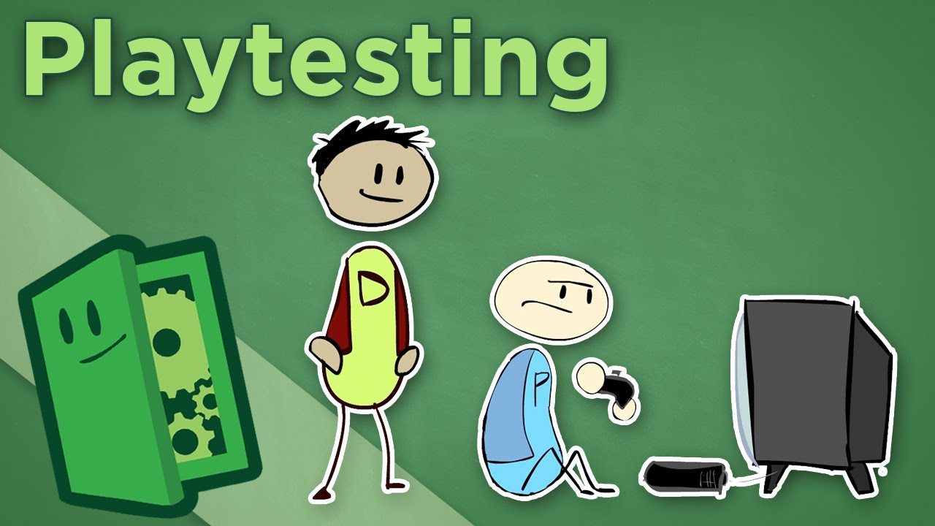
What have we learned?
Early play testing.
Communication.
JB & CP

Slide 13
Bibliography
Packard E. 2007. That teenage feeling. [Online]. April 2007. Available online: http://www.apa.org/monitor/apr07/teenage.aspx [Date of access: Thursday 13th October 2016].
Sounds obtained from:
https://incompetech.com/music/royalty-free/music.html

Slide 14
Questions.
?

